Slide 1
MANGROVE
FORESTS
Michelle

Slide 2
What are Mangroves?
Mangroves are tropical trees or shrubs which grow above the ground in coastal swamps, having numerous tangled roots submerged under the water

Slide 3
Mangrove Forests
Mangrove tidal forests are found in coastal areas with daily tides.
Tides are the rise and fall of sea levels caused by gravitational forces.
Mud and silt get collected on these coasts.

Slide 4
Where are Mangrove Forests Found In India?

Slide 5
Deltas of…
GANGA
MAHANADI
KRISHNA
GODAVARI
KAVERI

Slide 6
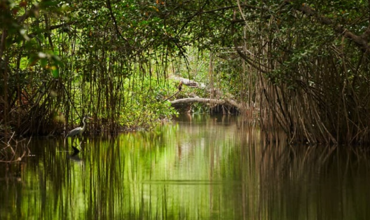
Sundarbans
Mangroves

Slide 7
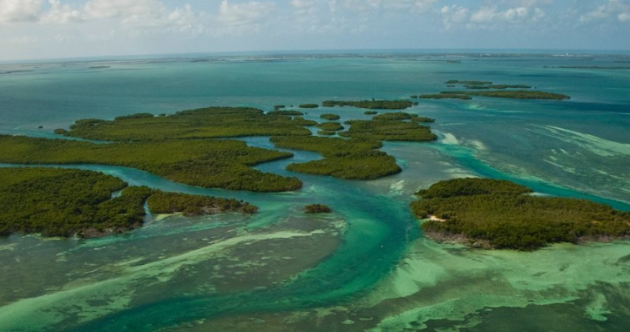
Florida
Mangroves

Slide 8
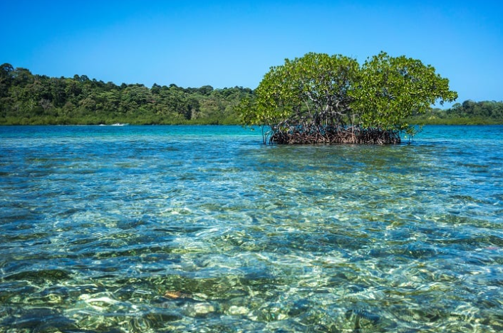
Gulf Of Panama Mangroves

Slide 9
Indus River Delta-Arabian Sea Mangroves

Slide 10
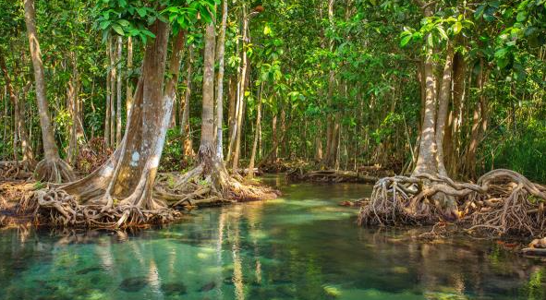
Belizean Coast
Mangroves

Slide 11
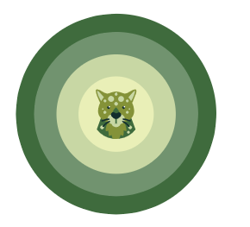
Trees found in Ganga-Brahmaputra Delta
Sundari trees which provide durable hard timber
Palm trees
Coconut
Keora
Agar

Slide 12
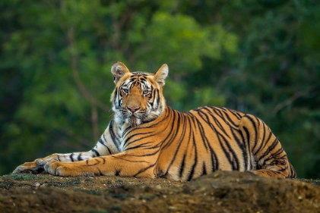
Biodiversity - Fauna
Royal Bengal Tiger

Slide 13
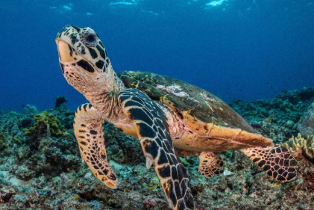
Turtles

Slide 14
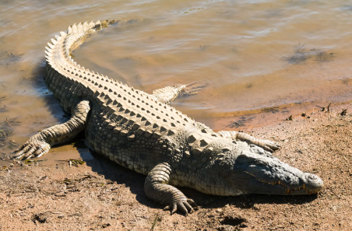
Crocodiles

Slide 15
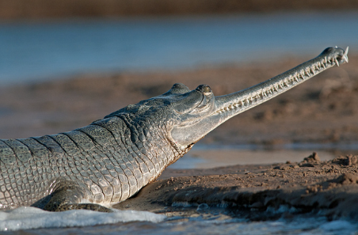
Gharials

Slide 16
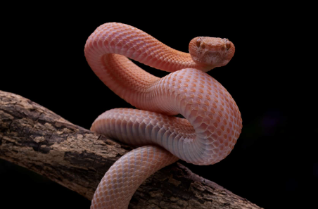
Snakes

Slide 17
INTERESTING FACTS
Many species of mangrove survive by filtering upto 90% of the salt out of seawater as it enters the roots
Mangrove forests protect about 340 threatened species around the world
They can store 10x more carbon per hectare than terrestrial forests

Slide 18
INTERESTING FACTS
Over 100 tropical and subtropical countries have mangroves along their coastlines
Some mangroves filter salt water through pores on their leaves
Mangroves can’t be replanted once destroyed

Slide 19
THANK YOU

